Slide 1
Microcontrollers: BASIC I/O in ATmega32/16
CSE 315
Microprocessors, Microcontrollers, and Embedded Systems

Slide 2
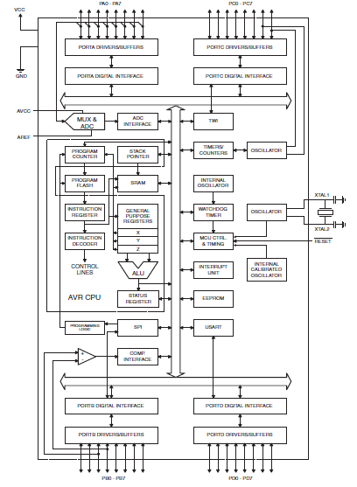
ATmega32
RISC
131 instructions
8 bit processor
16MHz
Flash program memory
SRAM for data
Timer, counter, ADC, USART

Slide 3
Ports for I/O
4 different ports for I/O
A, B, C, D
8 bit <-> 8 data pins
Every pin is bidirectional, can be used as input or output

Slide 4
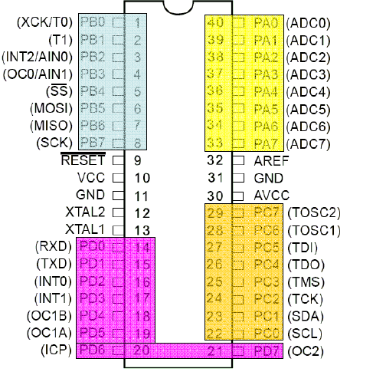
I/O Ports of ATmega32

Slide 5
Port Operation Registers
DDRx – Data Direction Register
PORTx – Pin Output Register
PINx – Pin Input Register
x = A, B, C or D i.e. DDRA, PORTA, PINA

Slide 6
Configuration
For configuration we have to use the Data Direction Registers
One register for each port
DDRx (DDRA, DDRB, DDRC, DDRD)
Configures each pin as input or output
Pin configuration
Input – 0
Output – 1

Slide 7
C Code Example
DDRA = 0b11111111;
Sets each bit of port A as output
DDRB = 0b00000000;
Sets each bit of port B as input
DDRC = 0b01010101;
???

Slide 8
Input
You have to read the PINx register
unsigned char ch; ch = PINA;
What to do if only some of the pins are configured as input ?

Slide 9
Output
You have to use the PORTx register
PORTB = 0b11111111;
What to do if only some of the pins are configured as output ?

Slide 10
Write a simple program to set the port D to 0xFF

Slide 11
C Code
#include <avr/io.h>
int main(void)
{
DDRD= 0b11111111; //initializing portD in //output mode
PORTD=0b11111111;//writing value to portD
while(1)
{
//TODO:: Nothing
}
}

Slide 12
Write a simple program to blink a LED on port B pin 0

Slide 13
C Code
#include <avr/io.h>
int main(void)
{
unsigned char c = 1;
DDRB= 0b00000001;
while(1)
{
PORTB = c;
if(c)c=0;
else c=1;
delay();
}
}
void delay()
{
unsigned char i,j,k;
for(i=0;i<255;i++)
for(j=0;j<255;j++)
for(k=0;k<100;k++);
}

Slide 14
Write a simple program to animate 8 LEDs connected to PORT B
One LED at a time is ON
The rest are off
At first LED 0 is on, then LED 1, and so on.

Slide 15
C Code
int main(void)
{
unsigned char c = 0x01;
DDRB= 0xFF;
while(1)
{
PORTB = c ;
if(c==1<<7)c = 1;
else c = c << 1;
delay();
}
}

Slide 16
Accurately Generating Delay
#include <avr/io.h>
#define F_CPU 1000000 // Clock Frequency
#include <util/delay.h>
int main(void)
{
while(1)
{
//1000 ms delay
_delay_ms(1000);
}
}

Slide 17
Simple Input
A 8 bit input is connected to PORT A
Show the input state on PORT B

Slide 18
C Code
int main(void)
{
unsigned char c;
DDRA = 0x00;
DDRB = 0xFF;
while(1)
{
c = PINA;
PORTB = c ;
}
}

Slide 19
Simple Counter
PA0 is connected with push button
1 when pressed
PORT B connected to 8 LEDs
Increment count when pressed the push button

Slide 20
C Code
int main(void)
{
unsigned char c=0,in=0;
DDRA = 0xFE;
DDRB = 0xFF;
while(1)
{
PORTB = c;
in = PINA;
if(in)
{
c++;
}
}
}

Slide 21
C Code
int main(void)
{
unsigned char c=0,in=0;
DDRA = 0xFE;
DDRB = 0xFF;
while(1)
{
PORTB = c;
in = PINA;
if(in)
{
c++;
}
}
}
There is a problem in the design.

Slide 22
C Code
int main(void)
{
unsigned char c=0,in=0;
DDRA = 0xFE;
DDRB = 0xFF;
while(1)
{
PORTB = c;
in = PINA;
if(in & 0x01)
{
c++;
_delay_ms(1000);
}
}
}

Slide 23
C Code
int main(void)
{
unsigned char c=0,in=0;
DDRA = 0xFE;
DDRB = 0xFF;
while(1)
{
PORTB = c;
in = PINA;
if(in & 0x01)
{
c++;
_delay_ms(1000);
}
}
}
There is still a problem in the design.

Slide 24
C Code
int main(void)
{
unsigned char c=0,in=0;
DDRA = 0xFE;
DDRB = 0xFF;
PORTB = c;
while(1)
{
in = PINA;
if(in & 0x01)
{
c++;
PORTB = c;
_delay_ms(1000);
}
}
}

Slide 25
Write a program to read a byte from PORT A and write it to PORT B

Slide 26
If input (taken from PORTC) is less than 100, send it to PORTB, otherwise, send it to PORTD

Slide 27
Write a program to read a byte from PORT A and write its upper nibble to PORT B (lower nibble) and lower nibble to PORT C (upper nibble)

Slide 28
Discussions on push buttons
This might seem like a reasonable connection
what is wrong with it ?
to microcontroller
a

Slide 29
Discussions on push buttons
This might seem like a reasonable connection
what is wrong with it ?
What is the voltage at terminal a when the button is not pressed?
to microcontroller
a

Slide 30
Pull Up Resistors
+5 V
to microcontroller
a

Slide 31
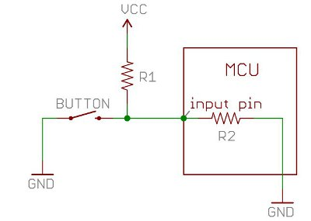
A deeper look

Slide 32
A deeper look
When the button is pressed, the input pin is pulled low. The value of resistor R1 controls how much current we want to flow from VCC, through the button, and then to ground.

Slide 33
A deeper look
When the button is not pressed, the input pin is pulled high. The value of the pull-up resistor controls the voltage on the input pin.

Slide 34
A deeper look
Because of the two opposing factors the resistor value cannot be too high not too low
Depending on the context you choose an appropriate value

Slide 35
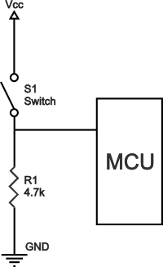
Pull Down Resistor

Slide 36
ATmega 32 has internal pull up resistors!
If PORTxn is written logic one when the pin is configured as an input pin, the pull-up resistor is
activated.
Here, x = A,B,C, or D
n is bit number, e.g., 0,1,2,..., or 7

Slide 37
General Discussion
If some pins are unused, it is recommended to ensure that these pins have a defined level.
The simplest method to ensure a defined level of an unused pin, is to enable the internal pullup.

Slide 38
Resources
DataSheet
Pull Up and Pull Down Resistors
http://www.resistorguide.com/pull-up-resistor_pull-down-resistor/
More on Pull Up and Pull Down resistors
https://learn.sparkfun.com/tutorials/pull-up-resistors

